Slide 1
CHAPTER 18:
The Internal Operating System
The Architecture of Computer Hardware, Systems Software & Networking:
An Information Technology Approach
5th Edition, Irv Englander
John Wiley and Sons ©2013
PowerPoint slides authored by Angela Clark, University of South Alabama
PowerPoint slides for the 4th edition were authored by Wilson Wong, Bentley University

Slide 2
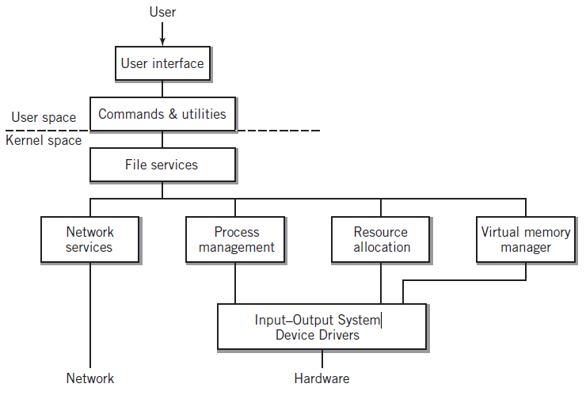
Hierarchical Model of an OS
Copyright 2013 John Wiley & Sons, Inc.
18-<number>

Slide 3
Primary Kernel Functions
File manager → translates logical file requests into specific physical I/O requests
I/O Control System (IOCS) → performs resource allocation and device management
Memory management → determines if it is possible to load programs and data into memory and if so where in memory
Scheduler → allocates time for the program to execute
Copyright 2013 John Wiley & Sons, Inc.
18-<number>

Slide 4
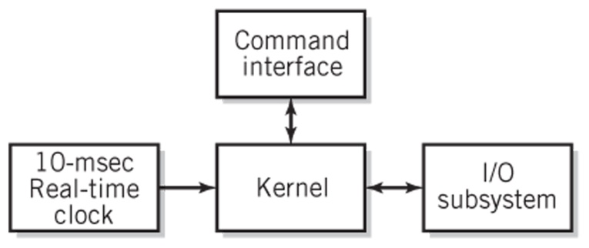
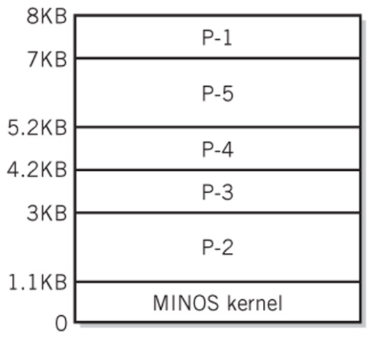
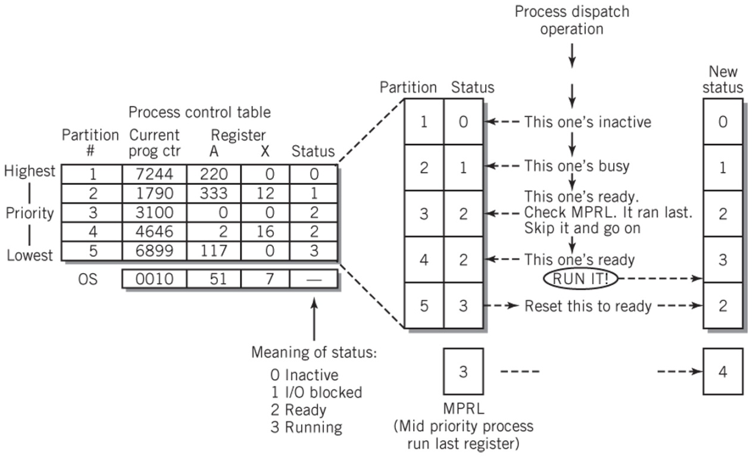
Miniature Operating System
Block Diagram
Memory
Map
Process Dispatch
Copyright 2013 John Wiley & Sons, Inc.
18-<number>

Slide 5
Bootstrapping
Execution begins with bootstrap loader (mini-loader, IPL) stored in ROM
Looks for OS program in a fixed location (possibly on the network)
Loads OS into RAM
Transfers control to starting location of OS
Loader program in OS used to load and execute user programs
Copyright 2013 John Wiley & Sons, Inc.
18-<number>

Slide 6
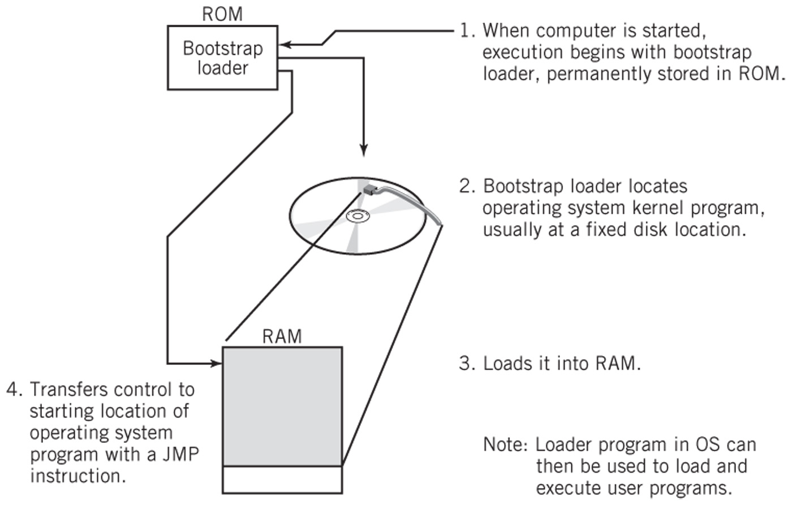
Bootstrapping
Cold vs. warm boot (does not retest the system)
Copyright 2013 John Wiley & Sons, Inc.
18-<number>

Slide 7
Process (1)
Process: basic unit of work in the OS
  A program together with all the resources that are associated with it as it is executed
  Program: a file or listing
  Process: a program being executed
Independent vs. cooperating processes
PID (process ID): a unique identifier for each process
Copyright 2013 John Wiley & Sons, Inc.
18-<number>

Slide 8
Process (2)
Process creation
  Forking, spawning, cloning a new process
  Parent and child processes
Process context
  All relevant register data including the program counter
  Allows interruption and restart invisibly
Copyright 2013 John Wiley & Sons, Inc.
18-<number>

Slide 9
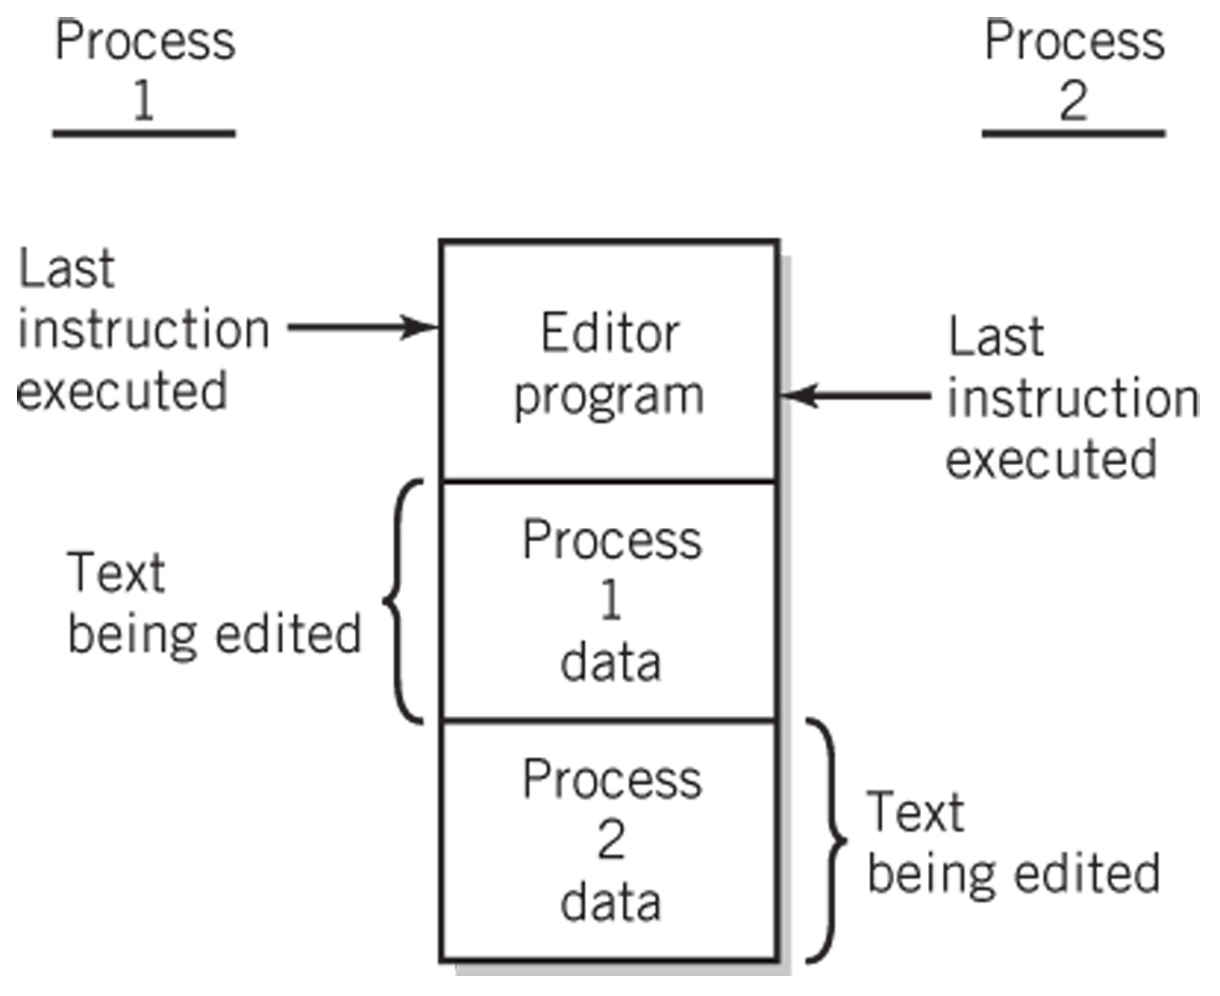
Two Processes Sharing a Single Program
Copyright 2013 John Wiley & Sons, Inc.
18-<number>

Slide 10
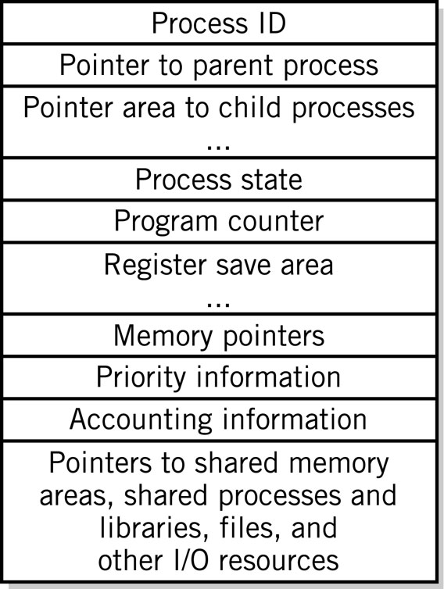
Process Control Block
A block of data for each process in the system
Contains all relevant information about the process
Typical process control block on the right →
Copyright 2013 John Wiley & Sons, Inc.
18-<number>

Slide 11
Process States
Three primary process operating states
  Ready state
  Running state
  Blocked state
Dispatching – Move from ready state to running state
Wake-up – Move from blocked state to ready state
Time-out – Move from running state to ready state
Process completion
  killed, terminated, destroyed
Additional states – suspend, swap
Resumption – Move from suspended state to ready state
Copyright 2013 John Wiley & Sons, Inc.
18-<number>

Slide 12
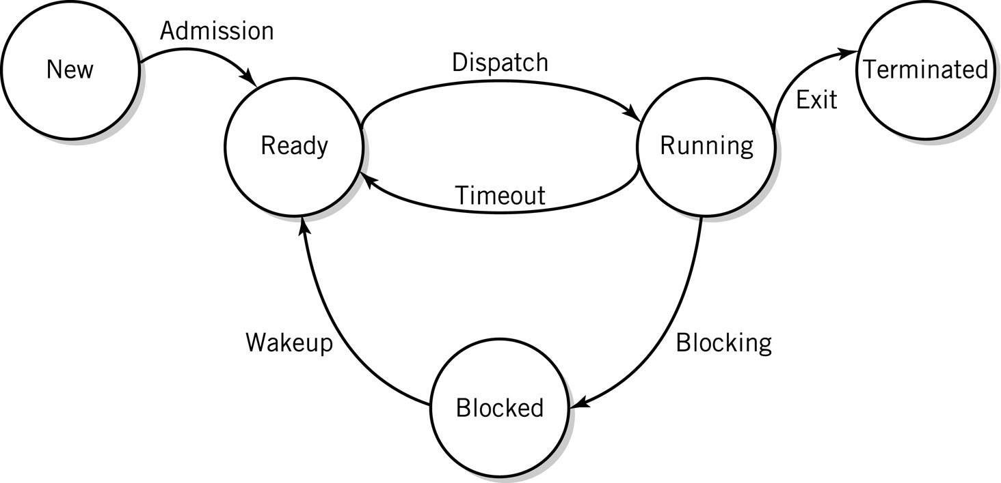
Process State Diagram
Copyright 2013 John Wiley & Sons, Inc.
18-<number>

Slide 13
Threads
‘Miniprocess’ that can be run independent of other parts of the process
  Event-driven programs
  Shares resources allocated to its parent process including primary storage, files, and I/O devices
  Each thread has its own context
Advantage of process/thread families over multiple independent processes:
  Reduced OS overhead for resource allocation and process management
  Substantially less information than a normal PCB
Copyright 2013 John Wiley & Sons, Inc.
18-<number>

Slide 14
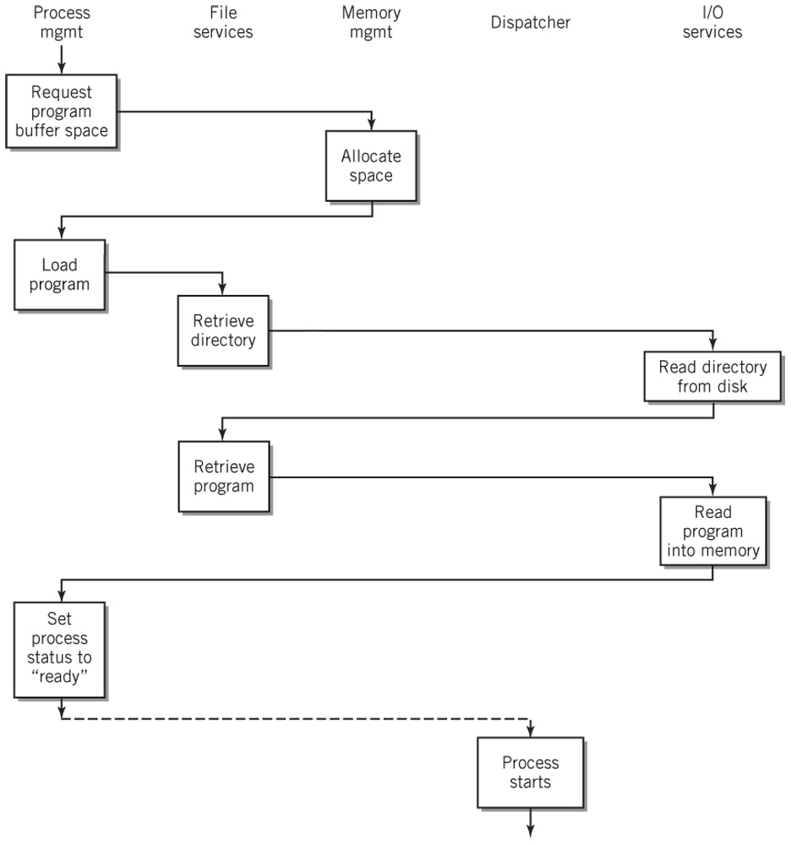
Loading and Executing a Process
Copyright 2013 John Wiley & Sons, Inc.
18-<number>

Slide 15
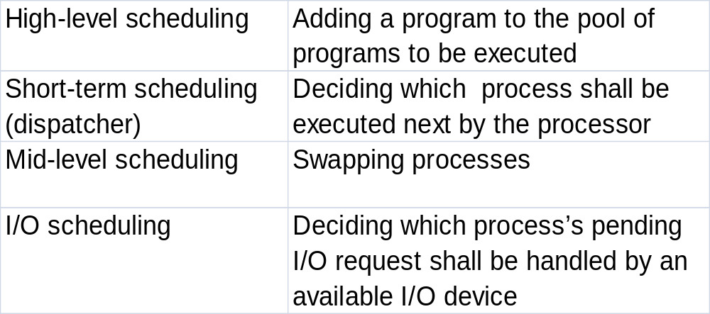
CPU Scheduling
Copyright 2013 John Wiley & Sons, Inc.
18-<number>

Slide 16
Dispatching Objectives
Ensure fairness
Maximize throughput
Minimize turnaround time
Maximize CPU utilization
Maximize resource allocation
Promote graceful degradation
Provide minimal and consistent response time
Prevent starvation
Copyright 2013 John Wiley & Sons, Inc.
18-<number>

Slide 17
Nonpreemptive Dispatching
First in, first out (FIFO)
  Unfair to short processes and I/O based processes
Shortest Job First (SJF)
  Longer jobs can be starved
Priority Scheduling
  Job with the highest priority is selected
  If multiple jobs have the highest priority then dispatcher selects among them using FIFO
Copyright 2013 John Wiley & Sons, Inc.
18-<number>

Slide 18
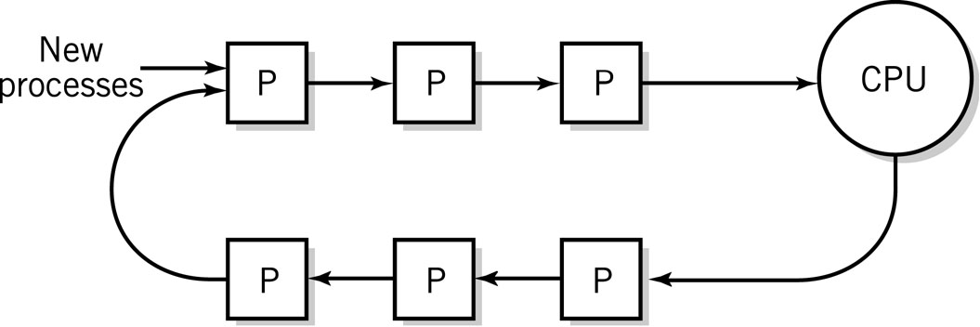
Preemptive Dispatching
Round robin
  Inherently fair and maximizes throughput
Dynamic Priority
  Based on ratio of CPU time to total time process has been in the system
  Smallest ratio has highest priority
  Linux; Windows 2000, XP, Vista, 7
Copyright 2013 John Wiley & Sons, Inc.
18-<number>
Notes:
each process gets the same amount of time, simple and inherently fair, good on maximizing throughput, jobs penalized for IO,
UNIX variation - calculates a dynamic priority based on the ratio of CPU time to total time, if no jobs have IO this reduces to RR
Multi-level feedback - hybrid algorithm, favors short jobs, favors IO bound jobs, processes enter at the first queue, and are given almost immediate CPU access, if they don’t finish the first time through they are assigned to the second level queue,

Slide 19
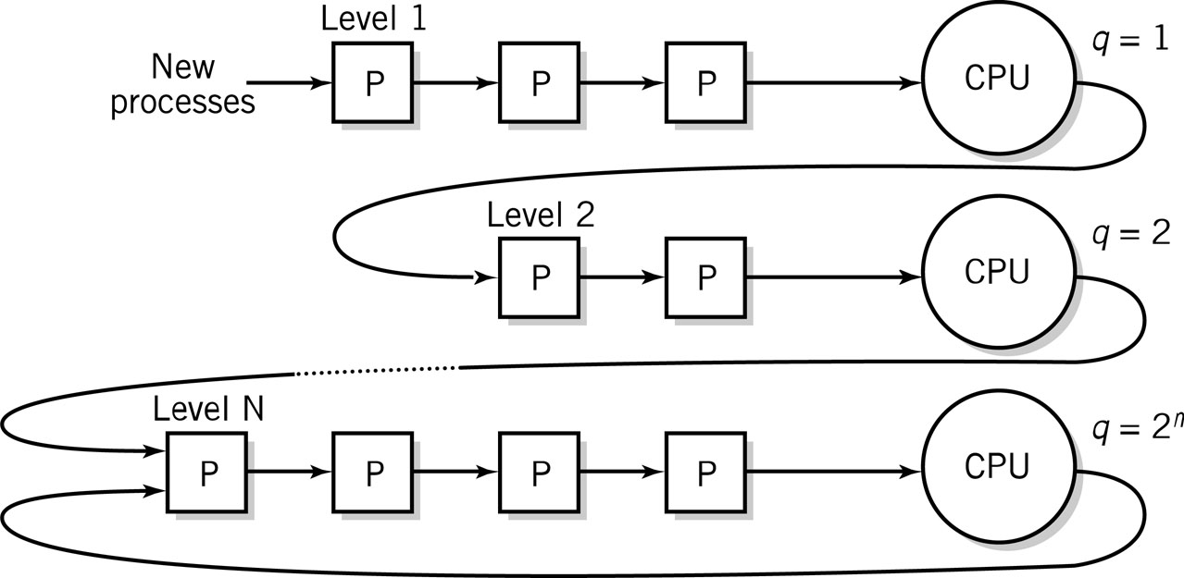
Preemptive Dispatching
Multilevel feedback queues
  Favors short jobs, I/O bound jobs
  Each level assigns more CPU time
Copyright 2013 John Wiley & Sons, Inc.
18-<number>

Slide 20
Memory Management
Goals
  Simple management for program loading
  Maximize use and waste as little as possible
Partitioning divides memory into fixed or variable spaces
  Best-fit, first-fit, or largest fit algorithm
Results in fragmentation
Copyright 2013 John Wiley & Sons, Inc.
18-<number>

Slide 21
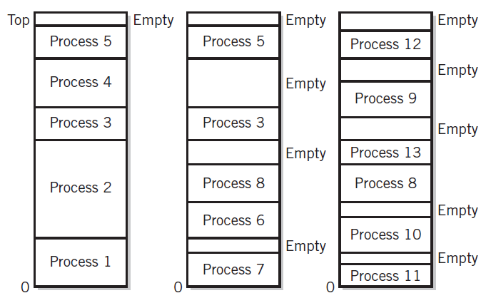
Variable Partitioning of Memory
Copyright 2013 John Wiley & Sons, Inc.
18-<number>

Slide 22
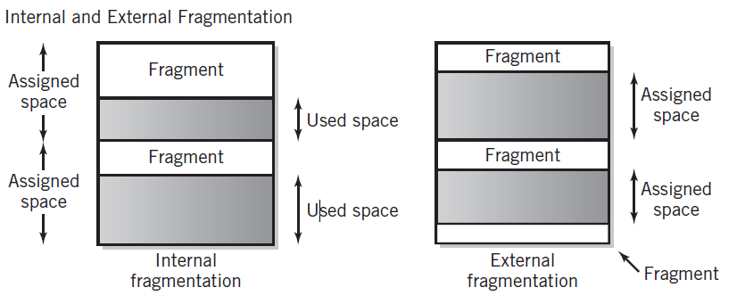
Internal and External Fragmentation
Copyright 2013 John Wiley & Sons, Inc.
18-<number>

Slide 23
Virtual Memory – Basic Ideas
Virtual memory increases the apparent amount of memory by using far less expensive hard disk space
Provides for process separation
Demand paging
  Pages reside on hard disk and are brought into memory as needed
Page table
  Keeps track of what is in memory and what is still out on hard disk
Inverted page table
  Representation of physical memory with the page that resides in each frame
Copyright 2013 John Wiley & Sons, Inc.
18-<number>

Slide 24
Pages and Frames (1)
 | Program | Memory
Unit | Page | Frame
Address | Logical | Physical
Size | 2 to 4KB | 2 to 4KB
Amount | # of bits in instruction word | Installed memory
Copyright 2013 John Wiley & Sons, Inc.
18-<number>

Slide 25
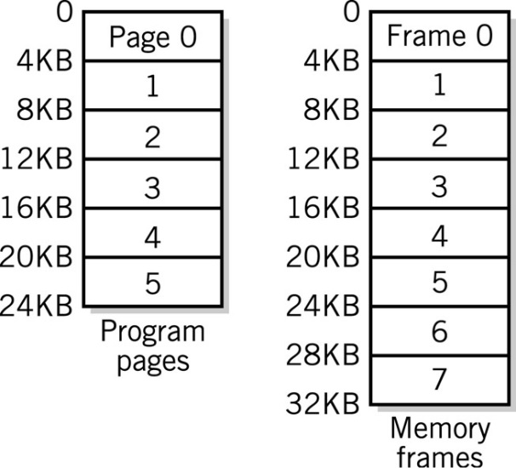
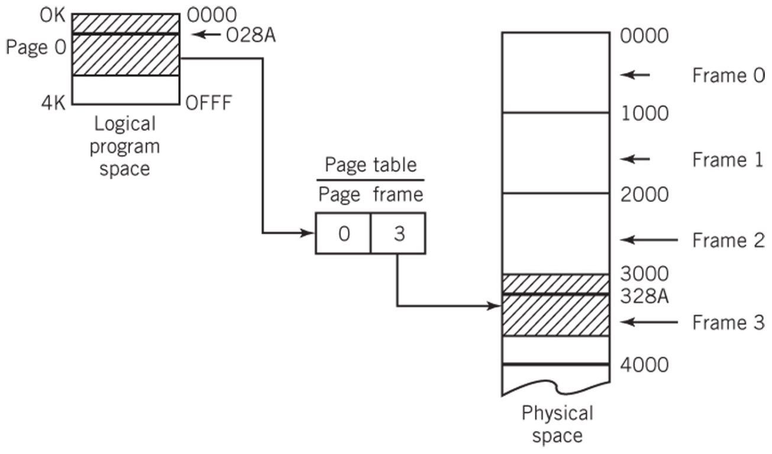
Pages and Frames (2)
Pages and Frames
A Simple Page Table Translation
Each program has its collection of pages.
The total number of pages can exceed the number of frames (physical memory).
Copyright 2013 John Wiley & Sons, Inc.
18-<number>

Slide 26
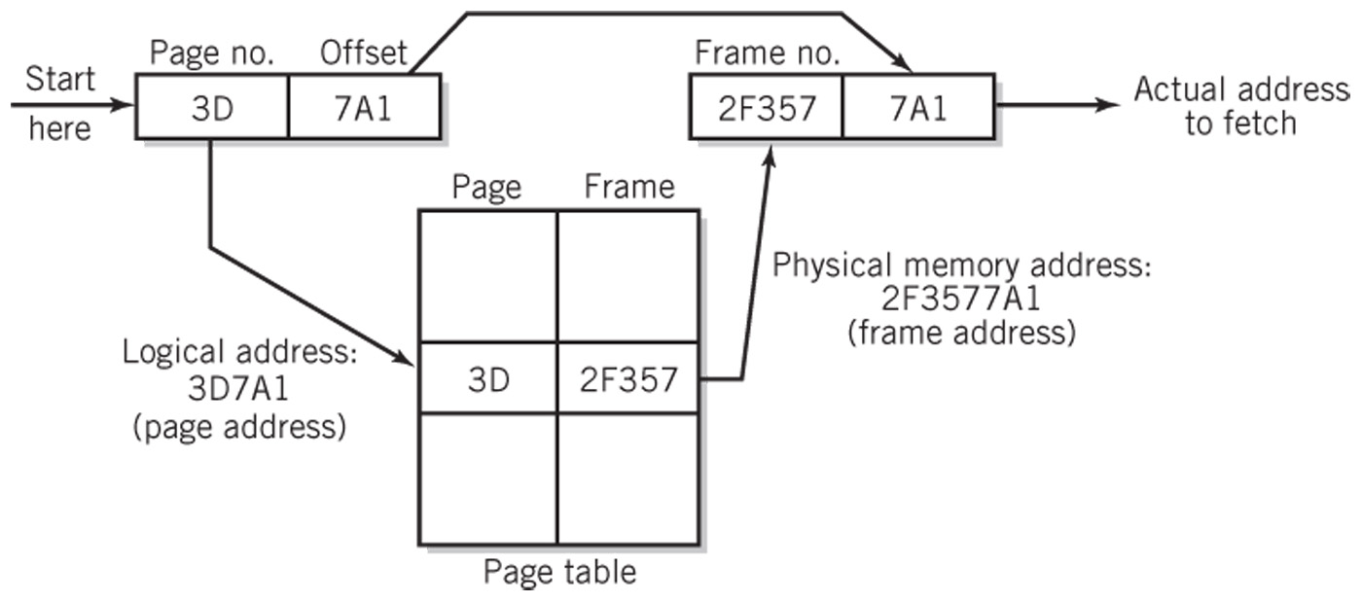
Page Translation Process
Copyright 2013 John Wiley & Sons, Inc.
18-<number>

Slide 27
Page Table
Page Frame
Pages not in main memory:
page fault when accessed
1
2
3
4
5
6
7
8
9
10
11
6
4
8
10
1
2
7
Disk
1
2
3
4
5
6
7
8
9
10
11
Swap space
Virtual Memory Pages
Copyright 2013 John Wiley & Sons, Inc.
18-<number>

Slide 28
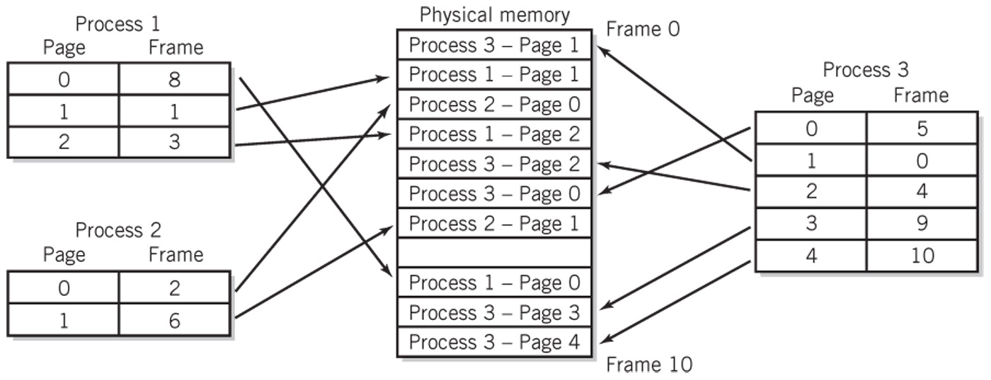
Mapping for Three Processes
Copyright 2013 John Wiley & Sons, Inc.
18-<number>

Slide 29
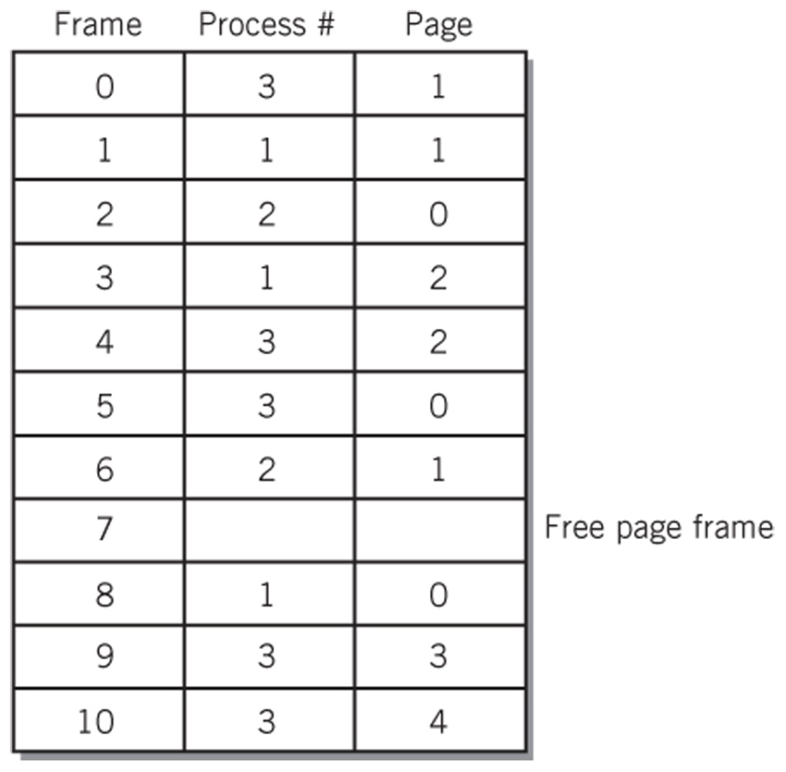
Inverted Page Table
Inverted Page Table for the previous slide
The table represents what is in physical memory
Copyright 2013 John Wiley & Sons, Inc.
18-<number>

Slide 30
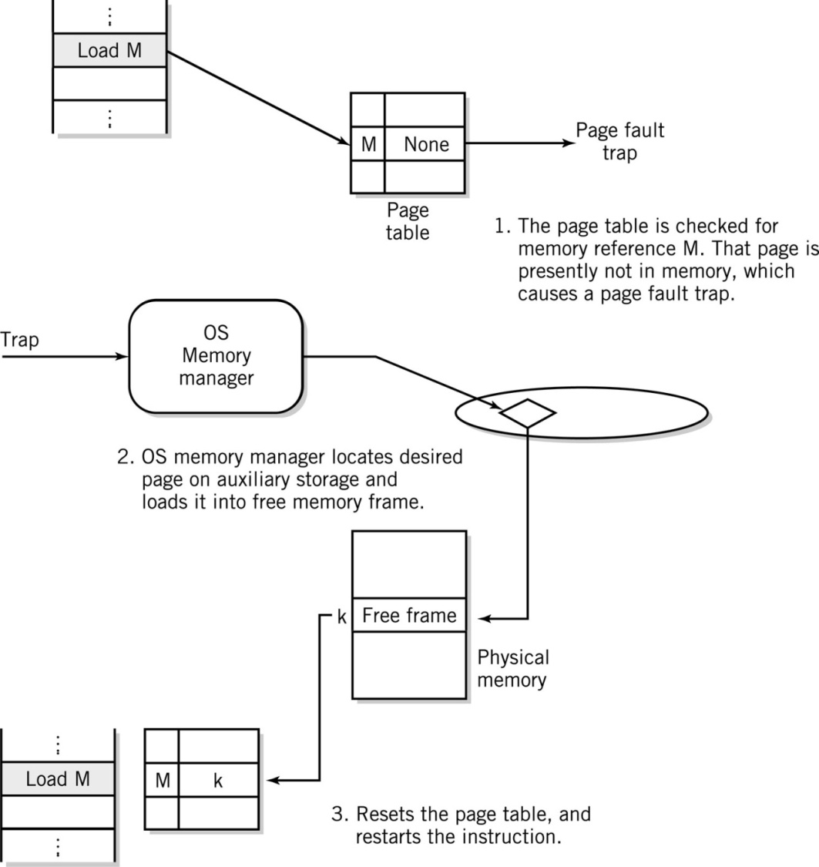
Steps in Handling a Page Fault
Copyright 2013 John Wiley & Sons, Inc.
18-<number>

Slide 31
Concept of Locality
Most memory references confined to small region
Well-written program in small loop, procedure, or function
Data likely in array and variables stored together
Working set
  Number of pages sufficient to run program normally, i.e., satisfy locality of a particular program
Copyright 2013 John Wiley & Sons, Inc.
18-<number>

Slide 32
Page Replacement Algorithms
Page fault
  Page is not in memory and must be loaded from disk
Algorithms to manage swapping
  FIFO – First-In, First-Out
    Belady’s Anomaly – when increasing number of pages results in more page faults
  LRU – Least Recently Used
  NUR – Not Used Recently
    Referenced bit
    Modified (dirty) bit
  Second Chance Replacement algorithms
Thrashing
  Too many page faults affect system performance
Copyright 2013 John Wiley & Sons, Inc.
18-<number>

Slide 33
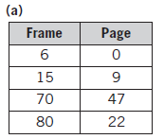

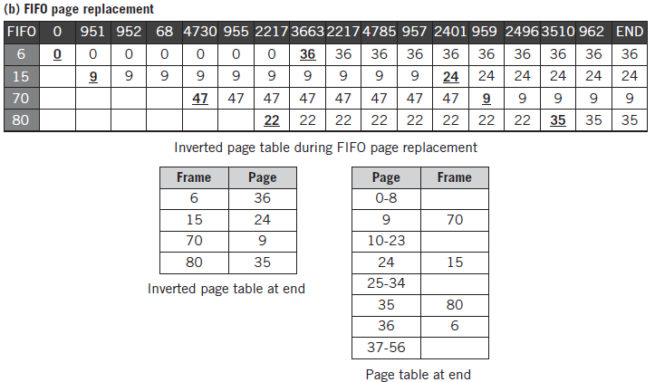
Solutions to the Page Table Example
Copyright 2013 John Wiley & Sons, Inc.
18-<number>

Slide 34
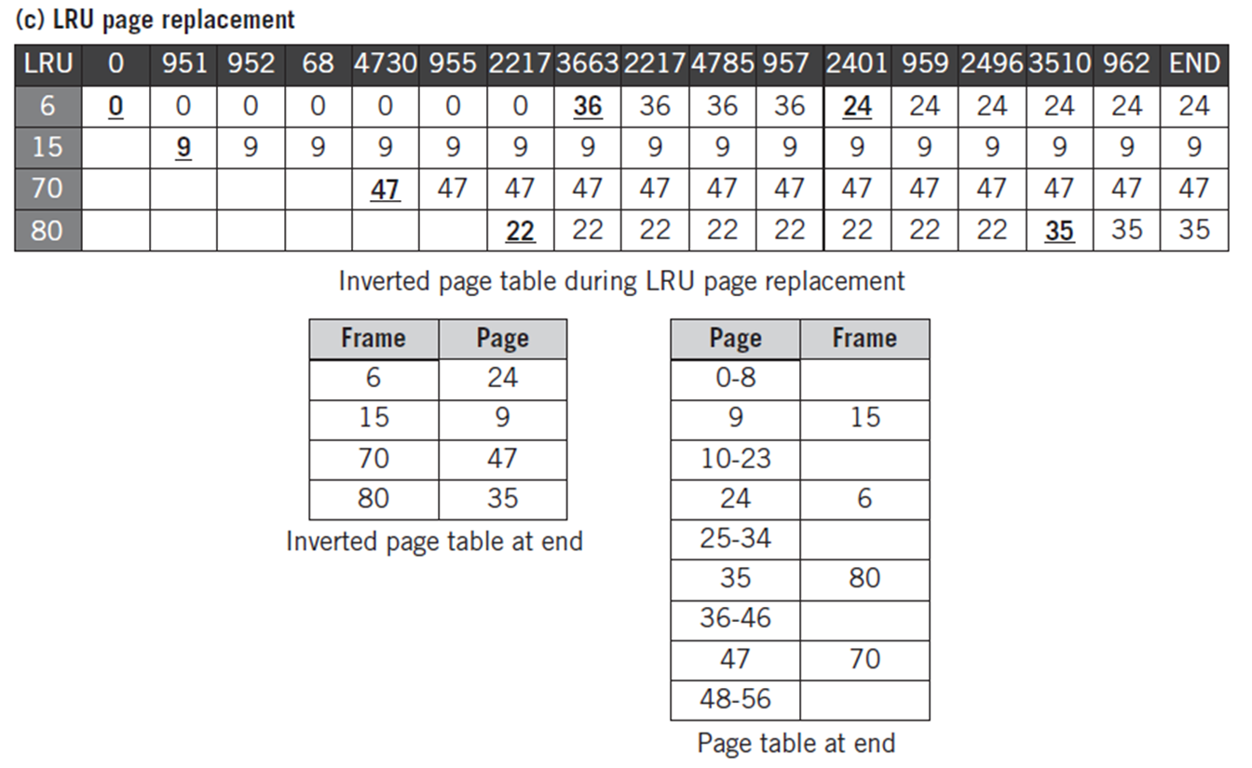
Solutions to the Page Table Example (cont.)
Copyright 2013 John Wiley & Sons, Inc.
18-<number>

Slide 35
Page Table Implementation
Associative memory improves access to the page table during the fetch-execute cycle
Addresses are assigned to each location as labels and stored in a translation lookaside buffer (TLB) table
May be stored in virtual memory
Copyright 2013 John Wiley & Sons, Inc.
18-<number>

Slide 36
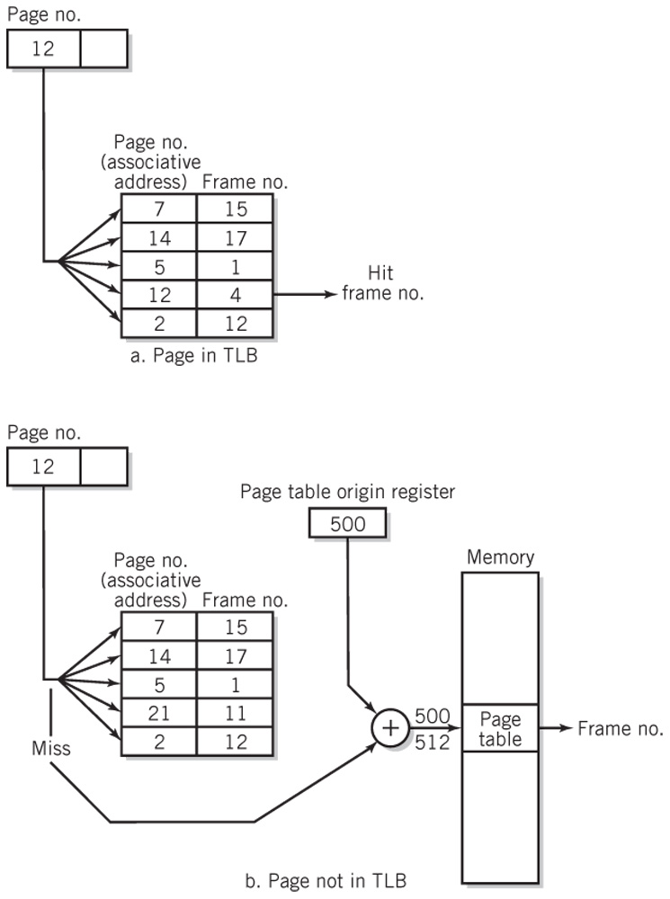
Frame Lookup Procedures
Copyright 2013 John Wiley & Sons, Inc.
18-<number>

Slide 37

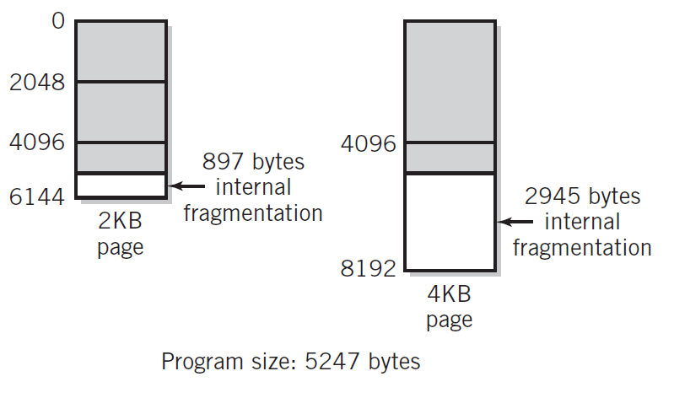
Internal Fragmentation
Copyright 2013 John Wiley & Sons, Inc.
18-<number>

Slide 38
Virtual Memory Tradeoffs
Disadvantages
SWAP file takes up space on disk
Paging takes up resources of the CPU
Advantages
Programs share memory space
More programs run at the same time
Programs run even if they cannot fit into memory all at once
Process separation
Copyright 2013 John Wiley & Sons, Inc.
18-<number>

Slide 39
Virtual Memory vs. Caching
Cache speeds up memory access
Virtual memory increases amount of perceived storage
  Independence from the configuration and capacity of the memory system
  Low cost per bit compared to main memory
Copyright 2013 John Wiley & Sons, Inc.
18-<number>

Slide 40
Secondary Storage Scheduling
FCFS – First-Come, First-Served
Shortest Distance First
  Indefinite postponement problem
Scan
  Middle of disk gets serviced twice
N-Step C-Scan
  Disk seek in only one direction
  Return after last request in queue served
  Two queues
    Queue of requests being processed
    Queue of new requests
Copyright 2013 John Wiley & Sons, Inc.
18-<number>

Slide 41
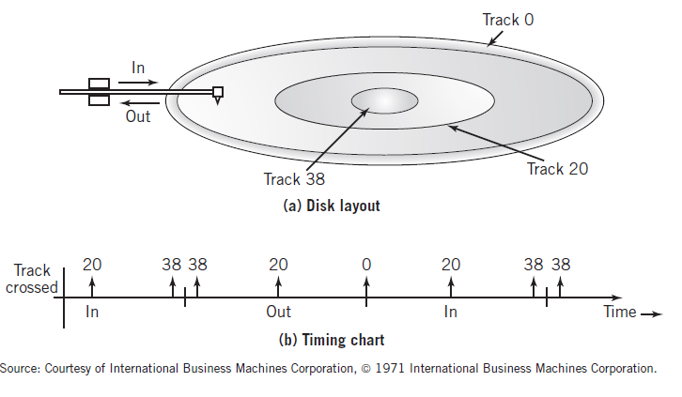
Scan Scheduling Algorithm
Copyright 2013 John Wiley & Sons, Inc.
18-<number>

Slide 42
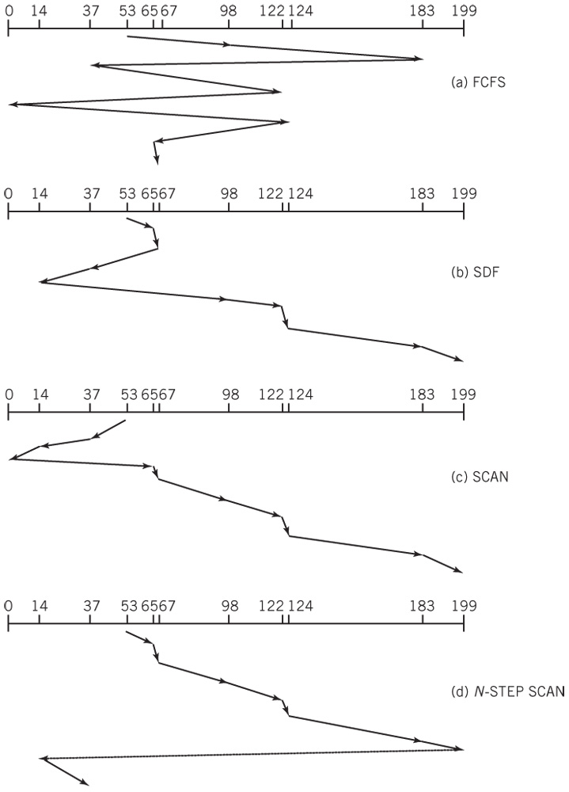
Comparison of Different Disk Algorithms
Copyright 2013 John Wiley & Sons, Inc.
18-<number>

Slide 43
Network OS Services
File transfer programs
Access to data files on other computers on the network
  Computer naming scheme is required for some network systems
Print services
  Print requests are redirected by the OS to the network station that manages the requested printer
Other peripheral sharing services
Web services
Messaging services
API network services
Security and network management services
Remote processing services
Copyright 2013 John Wiley & Sons, Inc.
18-<number>

Slide 44
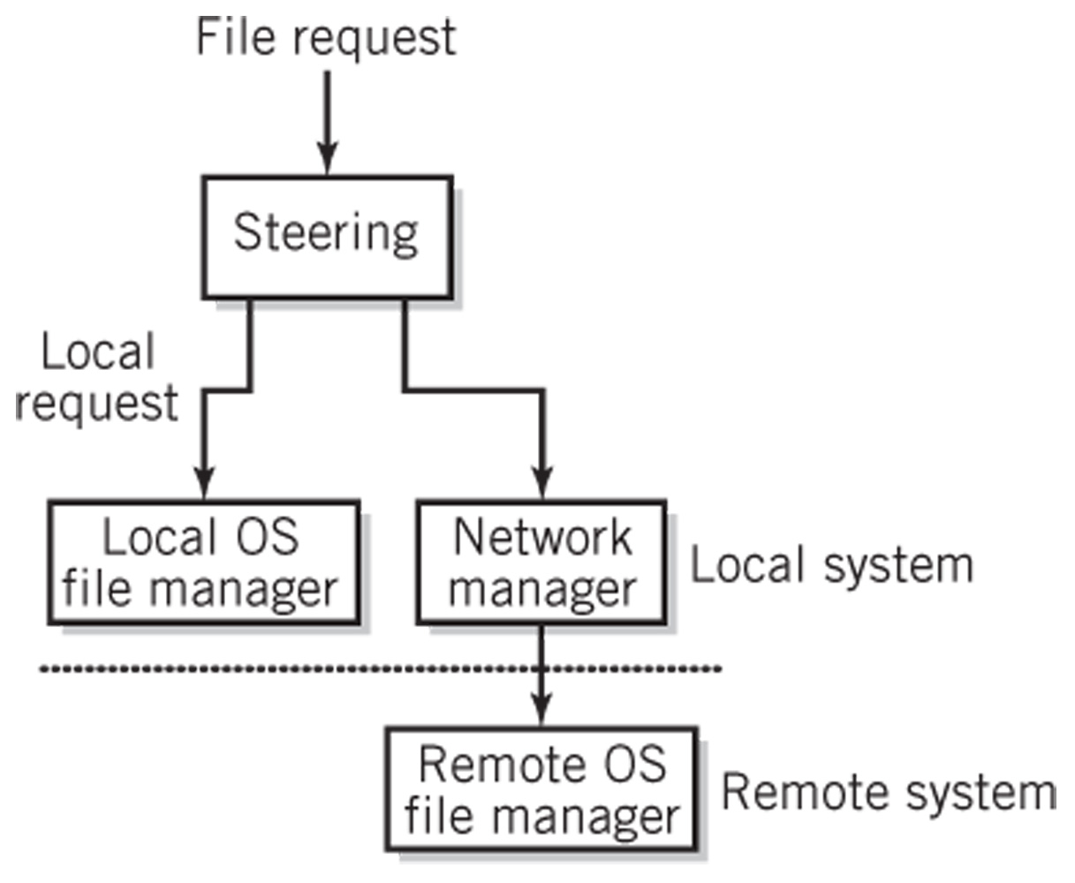
Access for a Networked OS
Copyright 2013 John Wiley & Sons, Inc.
18-<number>

Slide 45
Other OS Issues
Deadlock
  Two or more processes simultaneously have resources that are required by one another in order to proceed
  Prevention
  Avoidance
  Detection and recovery
Process Synchronization
  Required by cooperating processes when one process is dependent on the other
Copyright 2013 John Wiley & Sons, Inc.
18-<number>

Slide 46
Virtual Machines
Virtualization
  Using a powerful computer to simulate a number of computers
Virtual machines
  A simulated computer
Hypervisor
  Layer of software and/or hardware that separates one or more operating systems from the hardware
  Type 1 (native) – hypervisor software interfaces directly with the computer hardware
  Type 2 (hosted) – hypervisor software runs as a program on the operating system
Copyright 2013 John Wiley & Sons, Inc.
18-<number>

Slide 47
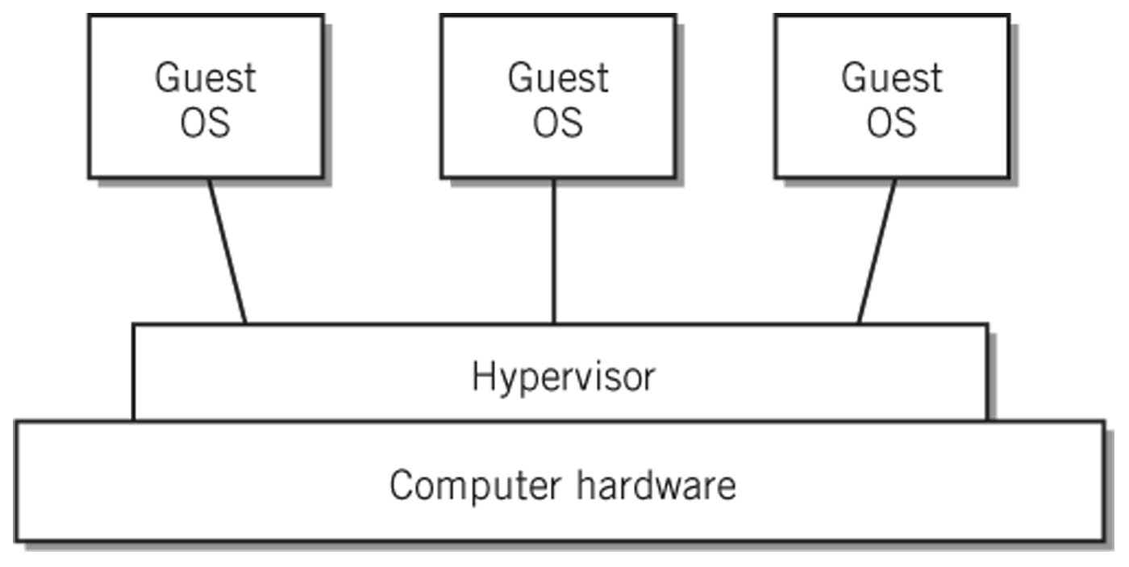
Virtual Machine Configuration
Copyright 2013 John Wiley & Sons, Inc.
18-<number>

Slide 48
Copyright 2013 John Wiley & Sons
All rights reserved. Reproduction or translation of this work beyond that permitted in section 117 of the 1976 United States Copyright Act without express permission of the copyright owner is unlawful. Request for further information should be addressed to the Permissions Department, John Wiley & Sons, Inc. The purchaser may make back-up copies for his/her own use only and not for distribution or resale. The Publisher assumes no responsibility for errors, omissions, or damages caused by the use of these programs or from the use of the information contained herein.
Copyright 2013 John Wiley & Sons, Inc.
18-<number>

